Slide 1


Week 8: Advanced resonance and stance
Ryan Ka Yau Lai
University of California, Santa Barbara

Slide 2

Before we start …
Open sbc007.rez
If you have a file saved from previous classes, please open that
If not, just open sbc007
Also, please go to Google Drive and download stance_anno.json from section materials
If you still remember how to load it into Rezonator, then please do that (& help your friends!)
And take note of the question + codeword on the board!

Slide 3

Question for today
Find one example of stance in SBC007. Tell us what the stance subject, stance object, positioning/evaluation, and (if any) alignment are.

Slide 4
In this class, you will …
Practise
Practise annotating resonance in SBC007 and justifying your response
Navigate
Navigate between groups of resonances in Rezonator using the Clique pane
Understand
Understand the three components of the stance triangle
Distinguish
Distinguish between different motivations for absence of resonance: Expressing a stance differential vs. ellipsis.
Appreciate
Appreciate the diversity of ways to express stance alignment in language

Slide 5
Let’s have some practice!

Slide 6
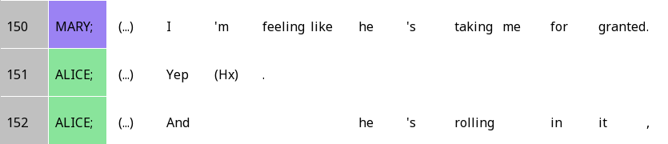
Taking me for granted (lines 150-152)

Slide 7
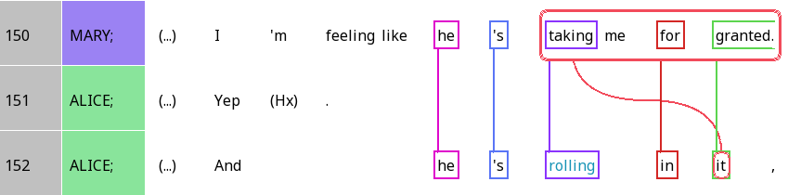
Taking me for granted - Tracks and rezzes

Slide 8
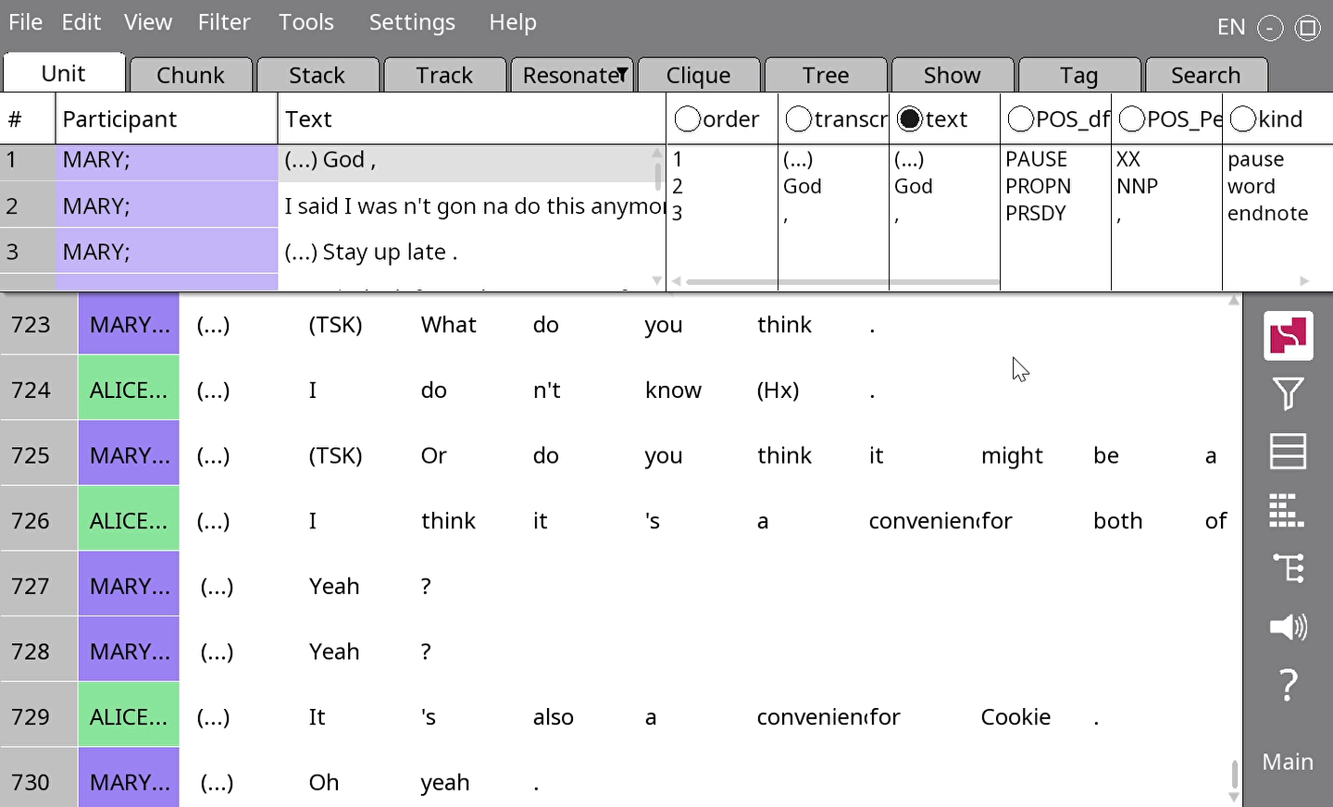
When words go offscreen
Use Settings > Narrow (or ctrl + -) to make the columns narrower
Use arrow keys to scroll horizontally

Slide 9
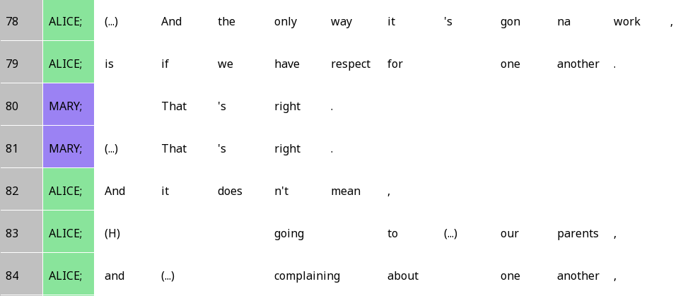
The only way it’s gonna work (lines 78-84)

Slide 10
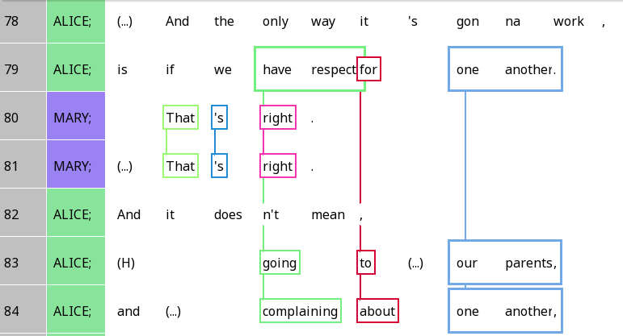
The only way it’s gonna work

Slide 11
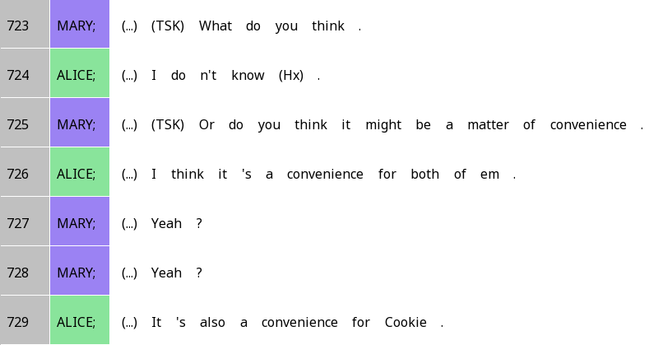
A matter of convenience

Slide 12
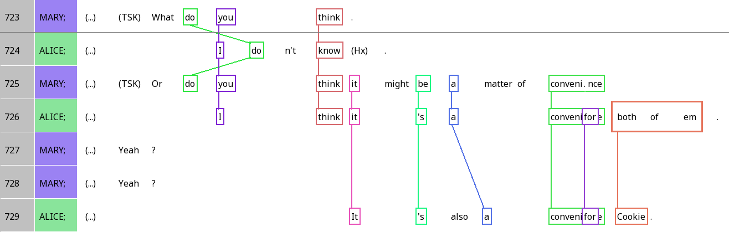
A matter of convenience

Slide 13

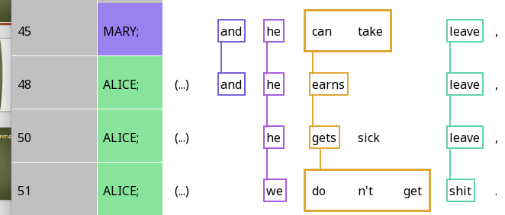
Cliques
A group of interlinked units

Slide 14
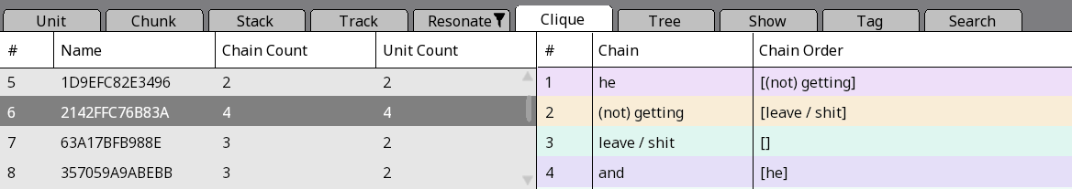
The clique pane
Number of resonances
Number of units
Specific resonance chain
Which chains can follow the present one?

Slide 15

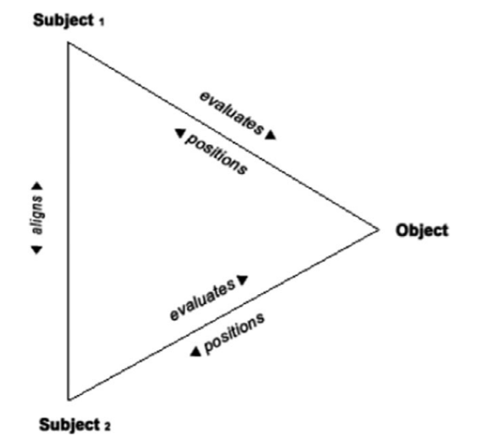



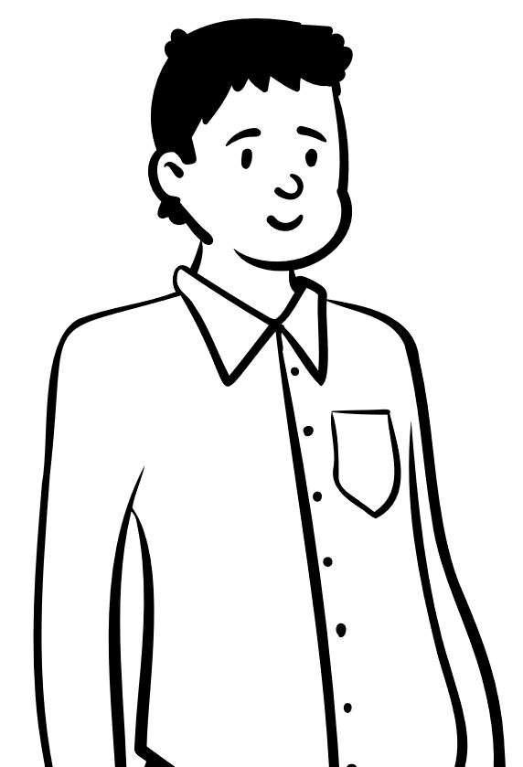

Stance
Stance subjects: The people taking stances
Stance objects: The phenomenon that people are taking a stance about
Evaluation & positioning: Stance subjects’ subjectivity towards the object (more later on)
Alignment: Do people agree, disagree, or have other relationships with the other person’s stance?

Slide 16
Diagraph form of the triangle (lines 306-307)
 | Stance subject | Position |  |  | Stance object |  |  |  |  | Alignment
Alice | I | do | n’t | know | if | she | ‘d | do | it
Mary | I | do | n’t | know | if | she | would |  |  | either
Stance subject
Alice
Position
Uncertainty
Alignment
Agreement
Stance object
if she’d do it
Position
Uncertainty
This is an example of epistemic stance, about your knowledge of the stance object
Stance subject
Mary

Slide 17
Positioning vs evaluation
Positioning: How the stance subject frames their feeling towards the stance object
Evaluation: What the stance subject thinks the stance object is like

Slide 18
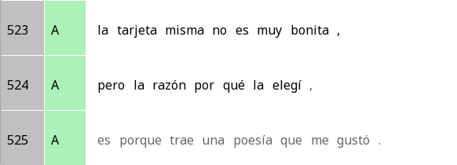
Positioning vs evaluation: Two sides of the same coin?
Evaluation
The card itself is not very pretty,
The card itself is not very pretty,
but the reason why I chose it,
Positioning
Is because it carries a poem that I liked.

Slide 19

Your turn!
Find one expression of stance in SBC007.
Name the stance subject, stance object, positioning/evaluation, and alignment.
NB: You can do your attendance question based on these.

Slide 20





Question: When people do not repeat words when resonating, what are they trying to say?

Slide 21
There’s a few possibilities …
They want to express a different opinion (stance differential)
They’re leaving out stuff that’s obvious and inferable (ellipsis)
They’re leaving out conjunctions that no longer matter (next week)
… The possibilities are endless

Slide 22
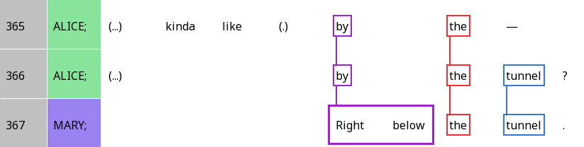
When silence is a stance differential
 | Stance subject | Position | Stance object |  |  | Alignment
Alice | (Alice) | kinda like | by | the | tunnel | ? (seeking confirmation)
Mary | (Mary) | (higher authority) | right below | the | tunnel | . (reserved agreement)

Slide 23
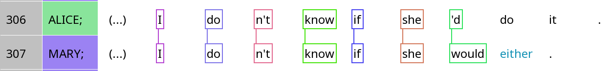
When silence is ellipsis
 | Stance subject | Position |  |  | Stance object |  |  |  |  | Alignment
Alice | I | do | n’t | know | if | she | ‘d | do | it
Mary | I | do | n’t | know | if | she | would | (do) | (it) | either
Question: Do you think ellipsis is more likely with frame resonance or focal resonance?

Slide 24
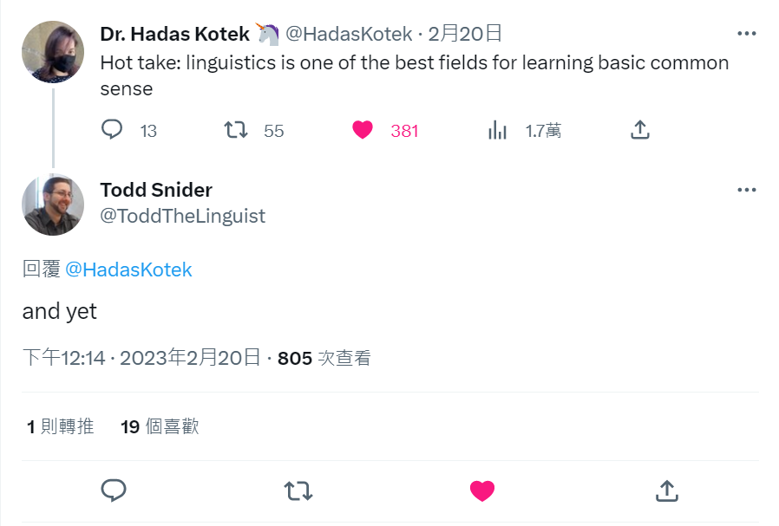
When it’s both …

Slide 25
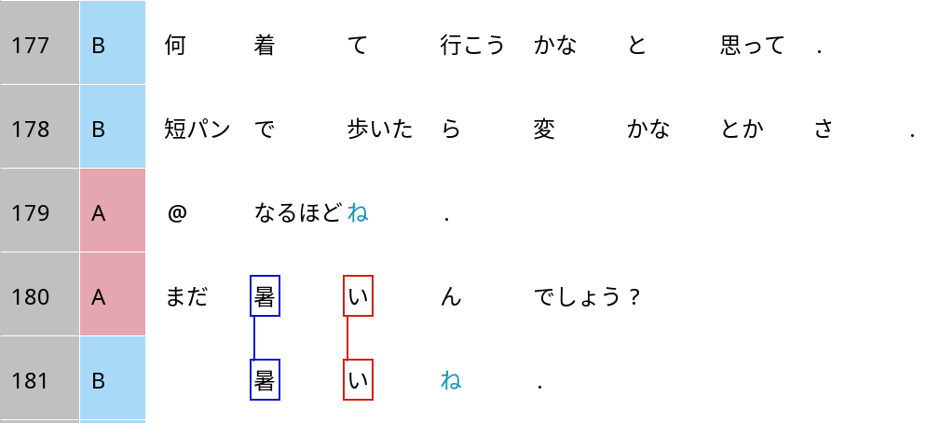
Grammaticalised stance alignment in Japanese: ne
I thought, what should I wear to go?
If I walk around in shorts, would it be weird and stuff?
I see ne.
It’s because it’s perhaps still hot (where B is)?
It’s still hot ne.

Slide 26
Grammaticalised stance alignment in Japanese: ne
It’s because it’s perhaps still hot (where B is)?
It’s still hot ne.
Stance object |  |  | Evaluation | Stance alignment
まだ mada | 暑い atsui | ん n | でしょう deshou | ? ?
still | hot | explanation | ‘Unsure, but I think yes’ | ‘I defer to your opinion.’
 | 暑い atsui |  |  | ね。 ne.
 | hot |  | No uncertainty | ‘Just as you thought.’

Slide 27
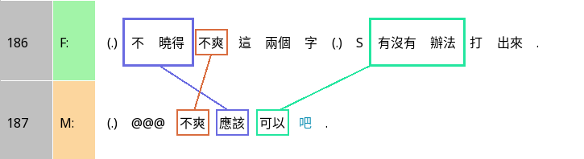
Grammaticalised stance alignment in Chinese: 吧 ba
I don’t know if the words ‘not cool’ can be typed out.
‘Not cool’ should be fine ba.

Slide 28
Grammaticalised stance in Chinese:吧 ba
I don’t know if the words ‘not cool’ can be typed out.
‘Not cool’ should be fine ba.
Positioning | Stance object |  |  |  | Evaluation |  |  |  |  | Alignment
不曉得 bù xiǎodé | 不爽 bù shuǎng | 這 zhè | 兩個 liǎnggè | 字 zì |  | 有沒有 yǒuméiyǒu | 辦法 bànfǎ | 打 dǎ | 出來 chūlai
Don’t know | not cool | these | two | words |  | Is there | way | type | out
 | 不爽 bù shuǎng |  |  |  | 應該 yīnggāi | 可以 kěyǐ |  | (ellipsis) |  | 吧 ba
 | not cool |  |  |  | should | can |  | (ellipsis)
‘I think so, though I’m not much more sure than you are’

Slide 29

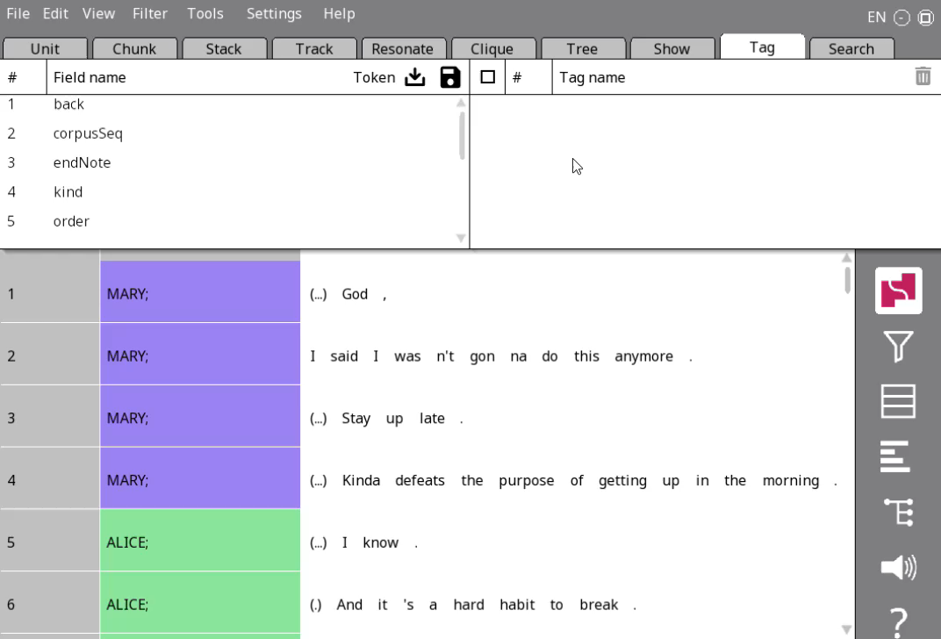
Adding a tag scheme (again)
Go to the Tag tab in the nav window
Click on the load icon
Navigate to your stance_anno.json file and select it (not shown in video)
Change the Token next to to Chain, and find a new field under Chain: stanceComponent (note: the ‘stance’ field, if you see one, is an error caused by a Rezonator bug)

Slide 30
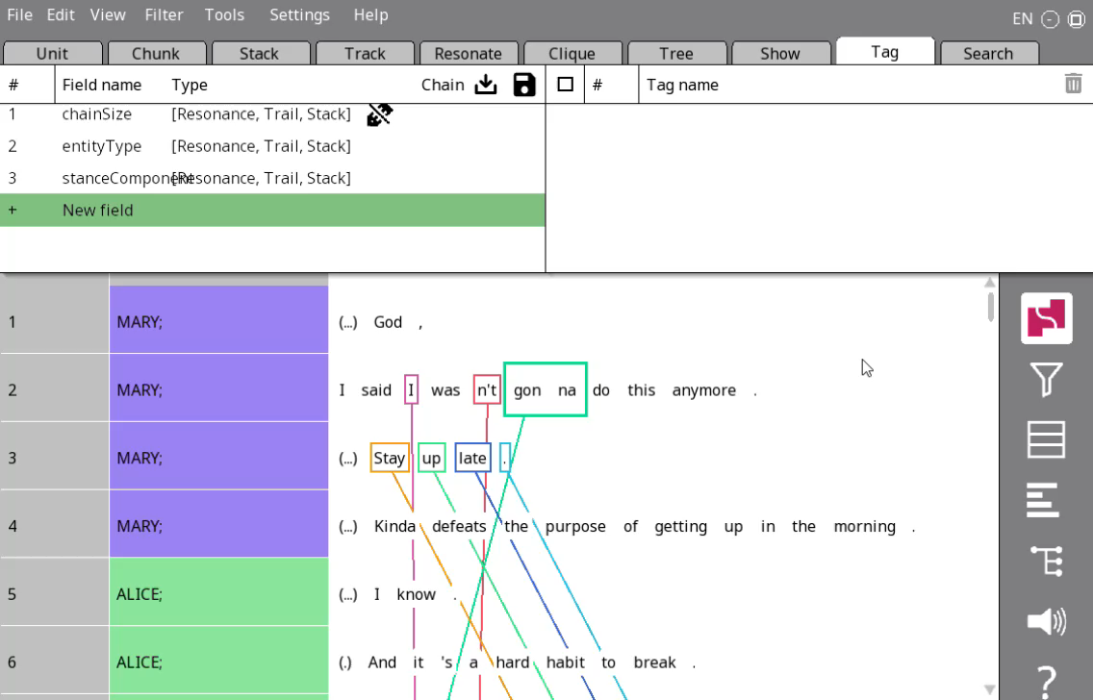

Changing visible columns (again)
Change to one-to-one mode
Navigate to the Chain tab
Click on the entityType column name, click Select field and choose stanceComponent

Slide 31
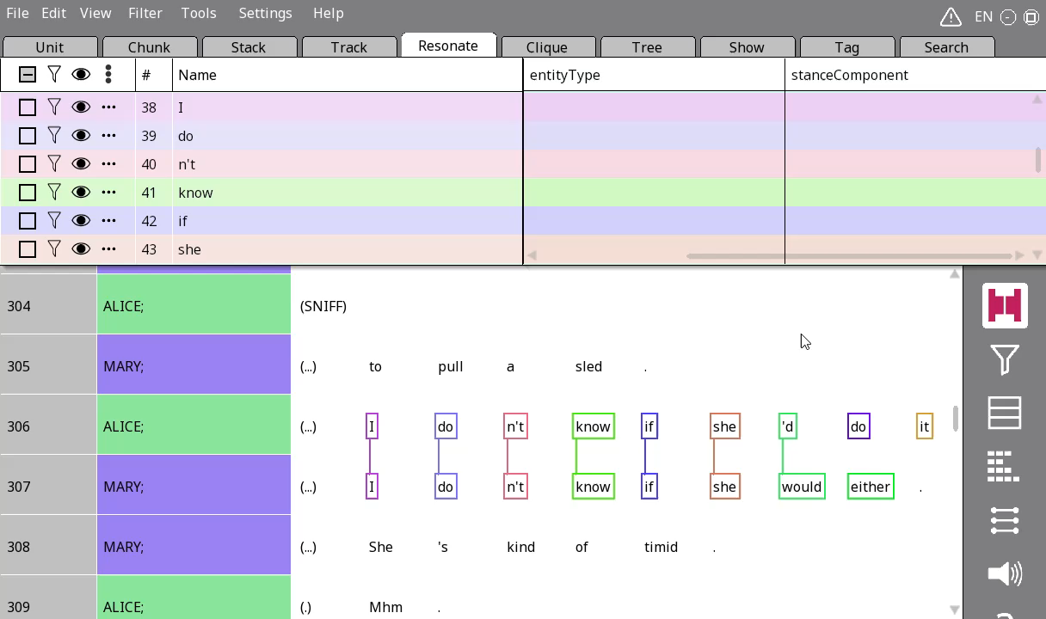

Annotating stanceComponent
Just click on the three dots and choose the appropriate component of the stance triangle

Slide 32
Your turn!
Go to lines 283-291.
Annotate the resonance, and put the stance-related non-resonating words in rezzes as well.
Annotate each resonance according to their role in the stance triangle.

Slide 33
Extras

Slide 34
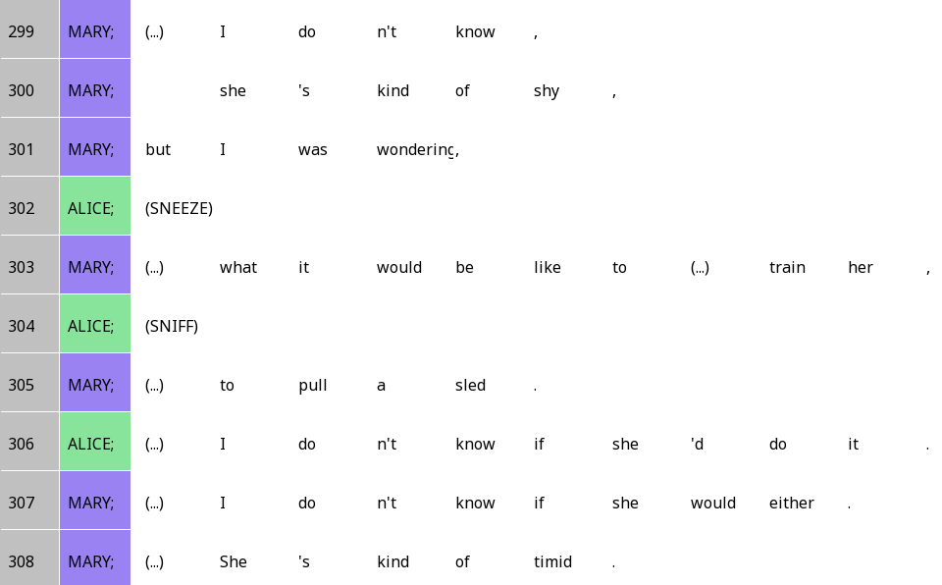
She’s kinda shy (lines 299-308)

Slide 35
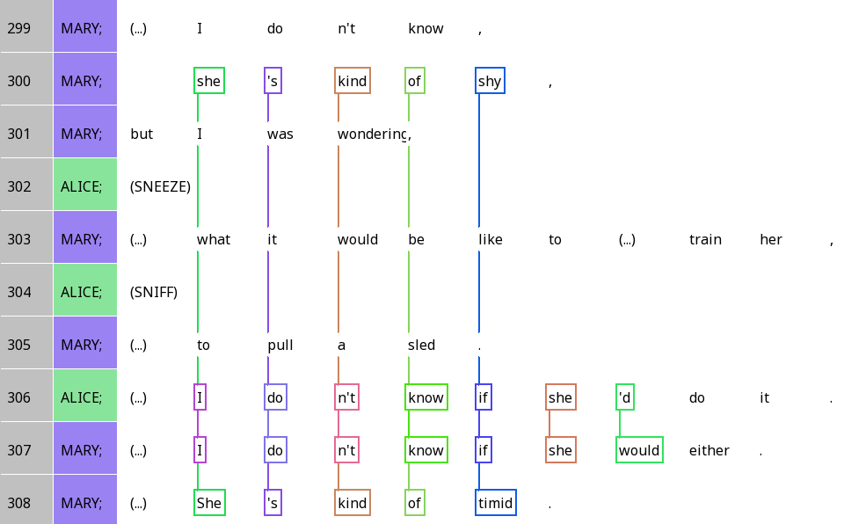
She’s kinda shy

